Slide 1
GUILHERME & TIAGO’S WEDDING
JUNE 6TH, 2026
100 GUESTS
YACHTS DE PARIS, PARIS
WEDDING MOOD BOARD

Slide 2
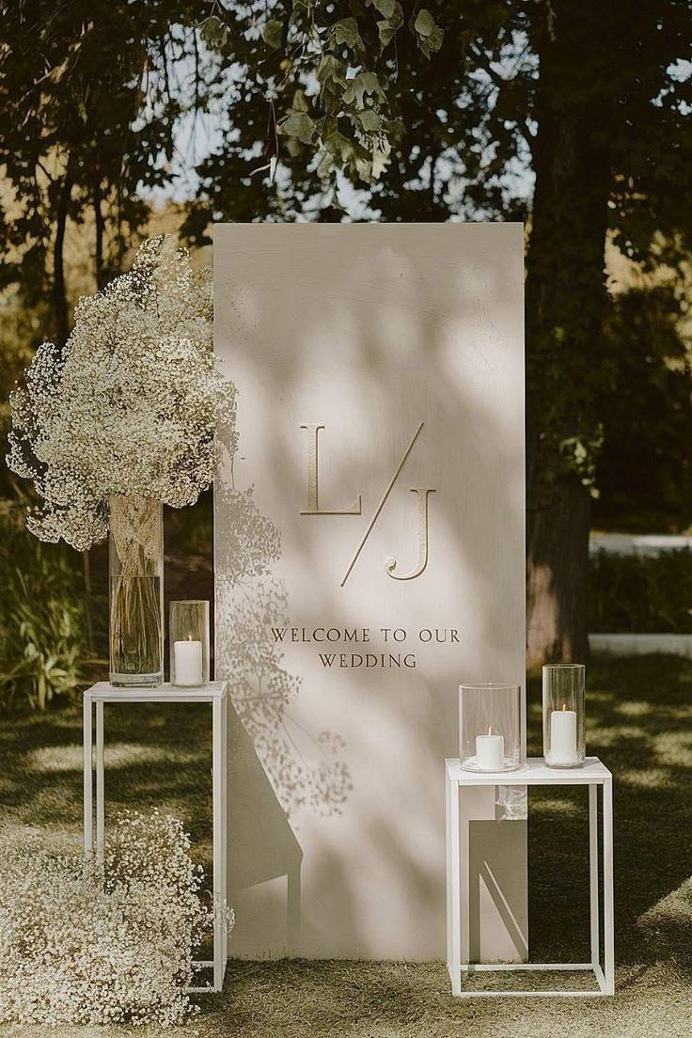
Welcome Sign & Décor
The wedding welcome sign features a clean and contemporary freestanding design with a soft ivory finish and an understated, elegant layout. The typography is minimal and refined, creating a timeless first impression that feels polished, modern, and effortlessly sophisticated
Styled with yellow floral arrangements displayed in tall ceramic vases for a delicate yet impactful effect, accompanied by candles in varying sizes to create a warm, refined, and beautifully layered presentation

Slide 3
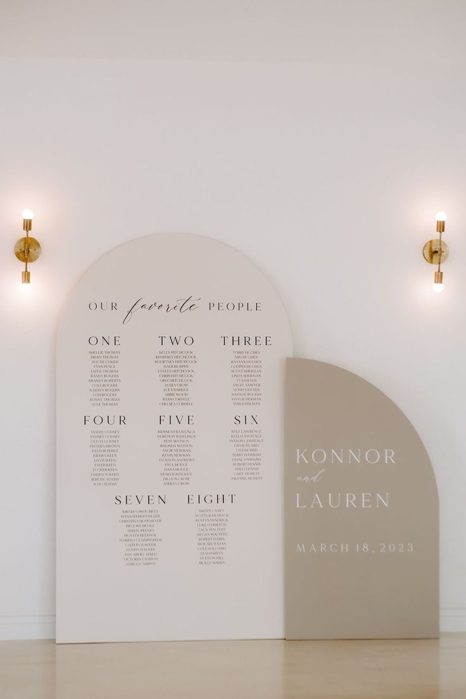
Seating Chart
This wedding seating chart features a modern and architectural design with softly curved panels in warm neutral tones, creating a clean and elevated visual statement. The layout is thoughtfully structured with refined typography, pairing a delicate script with a minimalist serif font for a timeless and sophisticated look

Slide 4
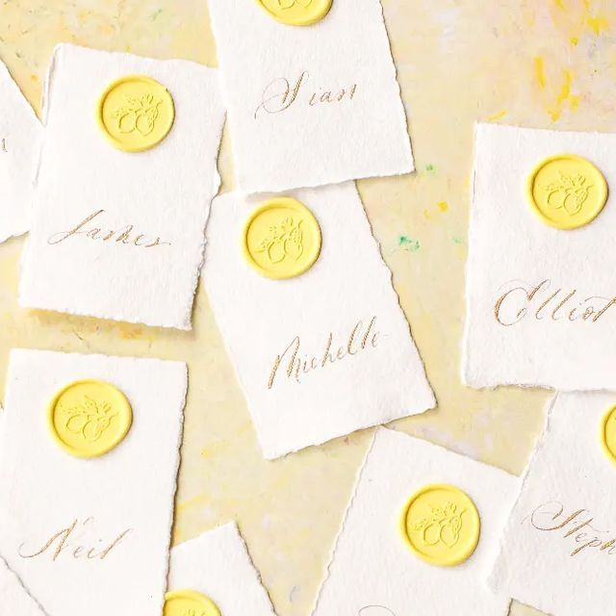
Place Cards
Audrey’s Note:
Please note that place cards are required by the catering staff regardless of round or rectangular tables. For weddings with more than 100 guests, place cards must be placed on each table with assigned seating, showing each guest’s full name, table number, and a meal icon/allergy note to guide the staff.

Slide 5
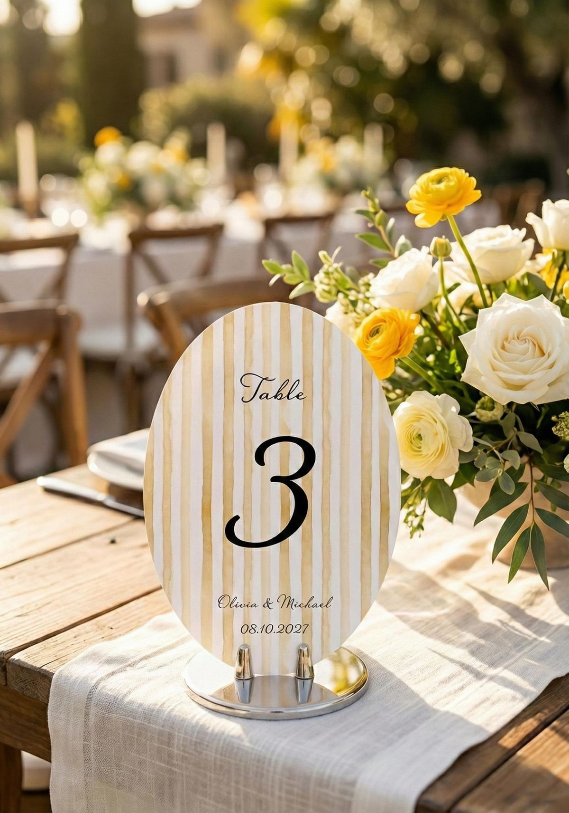
Table numbers
This wedding table number features an elegant oval design with soft ivory and light-yellow stripes, paired with refined typography for a timeless and elevated look. Displayed on a polished stand, it adds a chic and beautifully curated touch to the overall tablescape

Slide 6
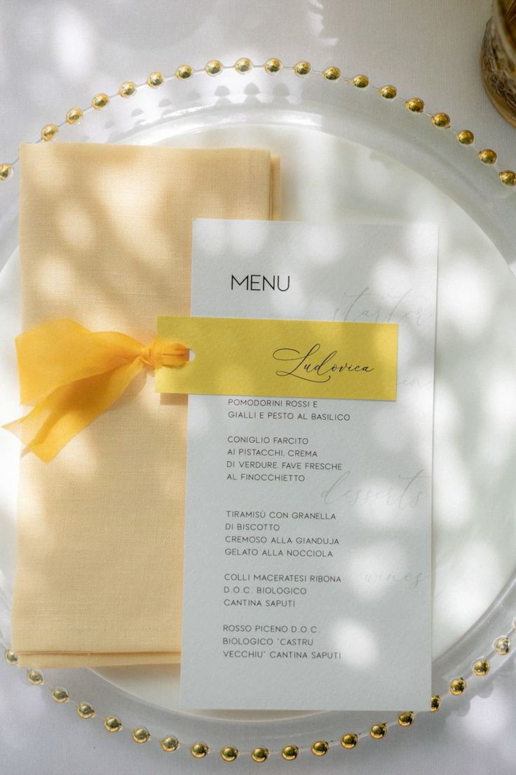
Menus
This wedding menu features a clean and refined design with soft, minimal typography on crisp white paper. It is paired with a delicate light-yellow napkin and a matching name card tied with a chiffon ribbon, creating a fresh, elegant, and thoughtfully coordinated place setting
Audrey’s note: To ensure visual consistency across the menus, place cards, and table numbers, the same font and color palette will be applied throughout. I would also recommend opting for a lace ribbon rather than satin to better complement the table numbers. Final details to be confirmed with Kiara.

Slide 7
We can’t wait to bring your vision to life!
The concepts (written and images) in this proposal are symbolic of the design inspiration we intend to bring to life for your event. Due to the characteristics of perishable items (flowers), there can be situations that may emerge that are completely out of our control.
To protect the integrity of our creativity, we kindly ask that you do not share the details of this proposal with other vendors bidding for your event. This was made just for you. However, please feel free to share this with your family.

Slide 8
NOTES FOR DESIGNER / IMPRIMEUR
100 menus
10 numero de tables
100 place cards – wax seal personnalisé
Seating Chart
1 welcome sign (pas besoin de fleurs, mais besoin des 2 petites structures blanches de chaque coté)

